Slide 1

CoviD-19 management system
By : Ahmed Nafiz

Slide 2
Objective
The objective of COVID19 MANAGEMENT SYSTEM is to automate the record of corona cases from various cluster of Bangladesh. This system typically enables the government or private medical department to keep track of the corona cases in the nation. Covid19 management system is used to keep track the records in a much simpler way. It allows easy management and tracking of various cluster in the country in fields such as active cases, death, recovered, negative cases on day to day basis. The case data and details are easily maintainable and accessible by every authenticate person . It helps to keep track, recognize and plan for reducing cases effectively . It is an effective system to help manage these activities in this pandemic time.

Slide 3
Data Processing
Collect case data
Analyze those data
Plan for reducing case

Slide 4
Platform and Tools
We use C++ programming Language. And we use Codeblocks, which is open source IDE for
writing this project in C++.
It supports GCC (GNU compiler Collection)
Goals
This project helps to keep track, recognize and plan for reducing cases effectively . It is an
effective system to help manage these activities in this pandemic time.

Slide 5
Reason behind the selection this topic
The Covid19 management system has been developed to override the problems prevailing
in the practicing manual system. This software is supported to eliminate and in some cases
reduce the hardships faced by this existing system. Moreover this system is designed for
the particular need of the government or institution to carry out operations in a smooth
and effective manner. The application is reduced as much as possible to avoid errors while
entering the data. It also provides error message while entering invalid data. No formal
knowledge is needed for the user to use this system. Thus by this all it proves it is
user-friendly. The developed Covid19 management system is more versatile, flexible
and updating can be done easily.

Slide 6
System design
Design of the Fields and Records

Slide 7
1. Design of the Fields and Records Covid19 management system is a detailed system and a menu driven application that helps to management system. It maintains the records of all cases in different fields.
1. COVID19 MANAGEMENT SYSTEM .
2. EXIT.
1. Case data management:
1. Add : Insert details of cases in a cluster.
2. Show : Display the cases in cluster details.
3. Modify : Modify the required field in the cluster database.
4. Search : Search the information about the required cluster.
5. Delete : Delete the cluster record.
6. Exit
2. Exit:
Exits the current screen/application

Slide 8
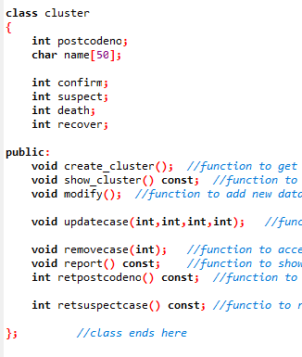
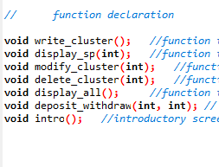
Summery –
Functions used in Project
Class used in Project

Slide 9
Output analysis
Sample Code with Output Testing

Slide 10
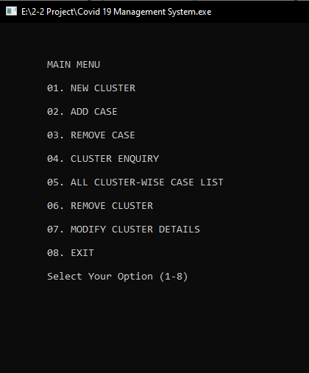
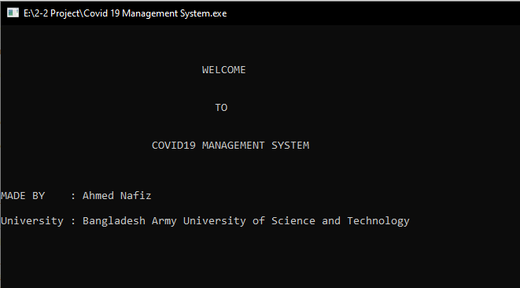
Menu

Slide 11
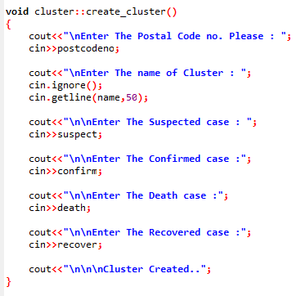
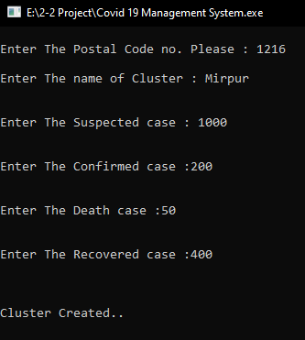
1. Insertion of a Record
Sample Code
Output

Slide 12
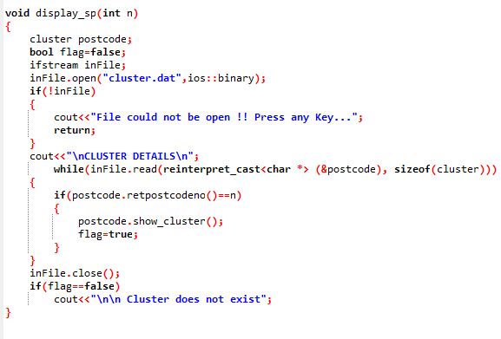
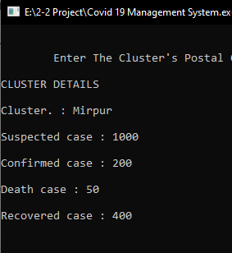
2. Searching of a Record
Output
Sample Code

Slide 13
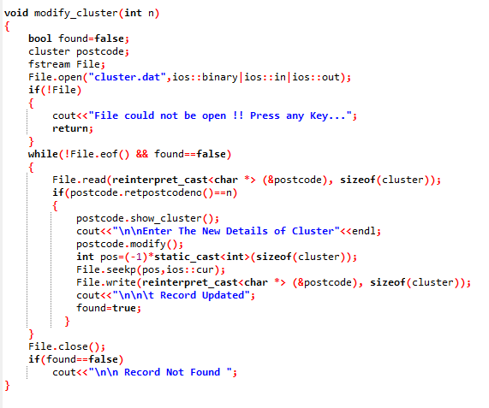
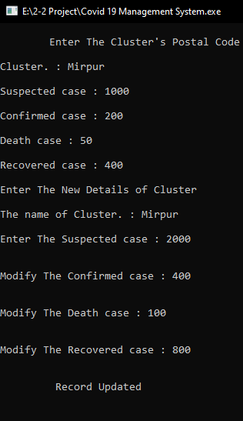
3. Modify a record
Output
Sample Code

Slide 14
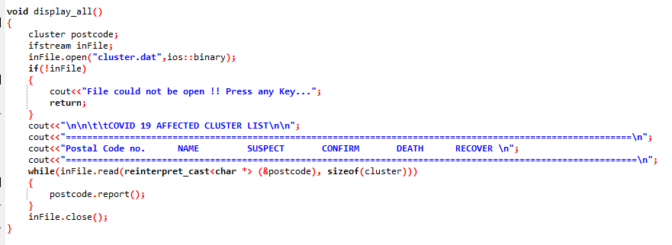
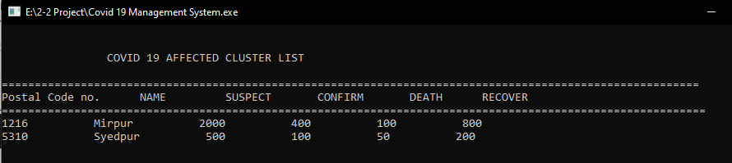
4. Display a Record
Sample Code
Output

Slide 15
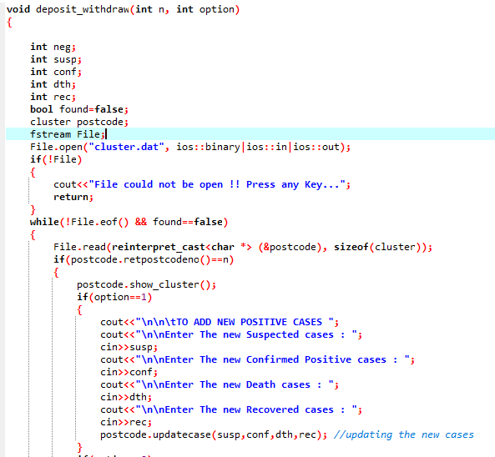
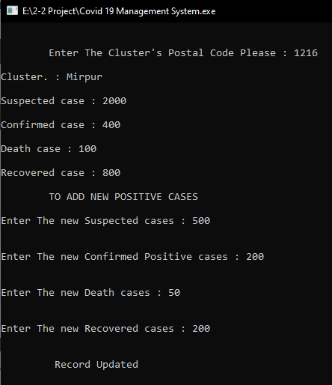
5. Add Case and Remove Case
Sample Code
Output

Slide 16
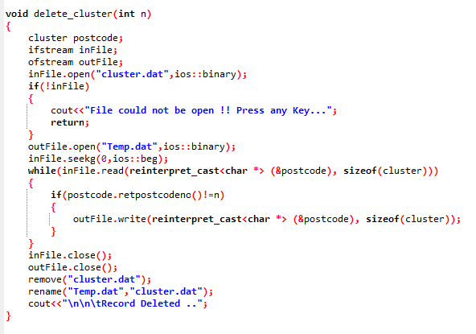
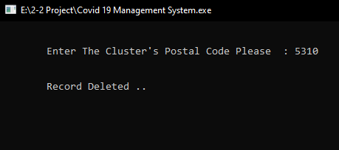
6. Deletion of a Record
Output
Sample Code

Slide 17
FUTURE ENHANCEMENTS
The Covid19 management system can be upgraded with more advanced software that support search engines and also work along with the internet connection. It can also be dynamically linked to the internet connection. The records can be viewed easily and more upgrades can be done in terms of the achievement details and the students who have achieved it. It can be connected with other departments within the institution with servers and the records can be stored in the servers along with protection to it.

Slide 18
REFERENCE
www.google.com
www.stackoverflow.com
www.youtube.com
File Structures –An Object Oriented Approach with C++ By Michael J.Folk, Bill Zoellick, Greg Riccardi
K.R. Venugopal, K.G. Srinivas, P.M. Krishnaraj: File Structures Using C++, Tata McGraw-Hill, 2008.
Dev-C++ on SourceForge.net

